Slide 1
Ethics
--or-- Why everyone hates moral philosophers

Slide 2
The definition of ethics (from Wikipedia)
Ethics, or moral philosophy, is a branch of philosophy that involves systematizing, defending, and recommending concepts of right and wrong conduct. The field of ethics, along with aesthetics, concerns matters of value, and thus comprises the branch of philosophy called axiology.
Ethics seeks to resolve questions of human morality by defining concepts such as good and evil, right and wrong, virtue and vice, justice and crime. As a field of intellectual inquiry, moral philosophy also is related to the fields of moral psychology, descriptive ethics, and value theory.

Slide 3


Disclaimer
I am not a moral philosopher, and this is not an area of expertise for me
Also I am a Slytherin… and most likely a Sith.
Any discussion of ethics must discuss ideas that are uncomfortable to be of any value
ideas and topics such as morality, gender, sexuality, race, etc.
Our beliefs are our beliefs and college is an ideal time to learn about what others believe
Bottom line: keep it civil.

Slide 4

Overview
This lecture will discuss the ethical decisions that face software developers in general and video game developers specifically
I don't have answers, only questions.
I chose video game developers for two reasons:
Video games encapsulate most of the ideas behind software engineering
CST 426 already required a talk on ethics

Slide 5
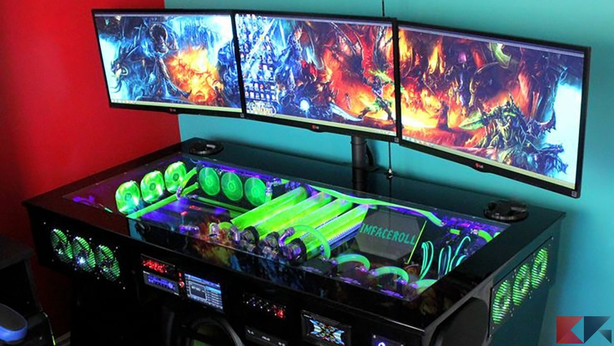
Defining Computer Games
"Technological-recreational fantasy entertainment"
An Abstract experience
Players may identify with/as the characters they control, it is still a virtual identity.
"Game play is its own reward and is clearly distinguished from ordinary life" Therefore real moral values and principles may not be applicable.

Slide 6


External Ethics: Piracy
Defined:
Cost: $8,000,000,000 +/-
How do we calculate the cost?
Lost revenue?
'Damage'?
One paper suggests[1] that pirating software has positive externalities in the form of growth to small businesses

Slide 7
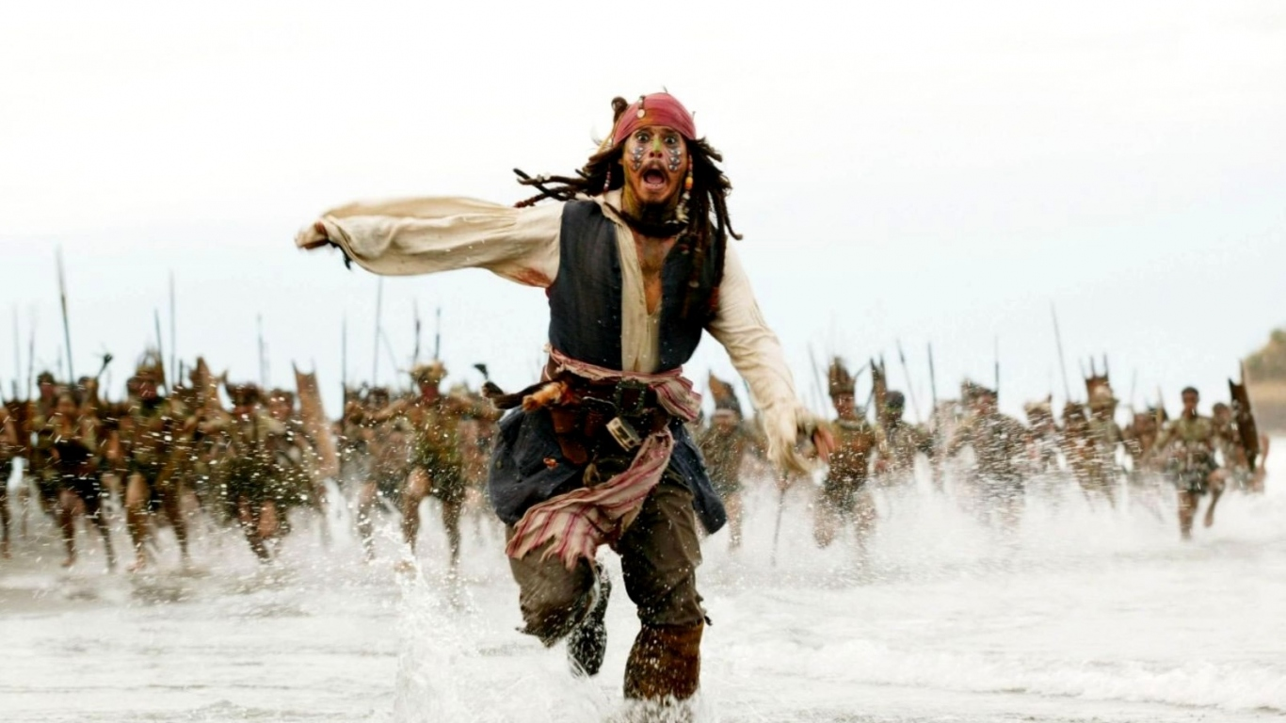
Is it okay if…
…the pirate was never going to buy the software to begin with?
…the pirate is replacing a lost or (ironically) stolen copy?

Slide 8

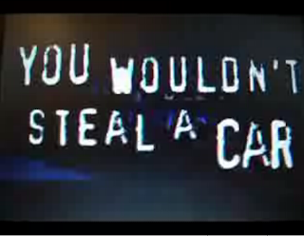
Question
Have you ever pirated software?
What was the rationale for breaking the law?
(BTW this is known as a loaded question which is to say it implies a moral standing in the way it is asked)
How does pirating differ from shoplifting?

Slide 9
Censorship and ratings
ESRB and PEGI are both self regulated [2][3][4][5]
Main purpose: to evaluate the suitability of a game for a given audience.
Basically the thought was: "Regulate ourselves or be regulated"

Slide 10

Thoughts on Regulation and Ratings
Who should decide on ratings?
Should/can developers put whatever content they want in a game?
Who decides what gets censored?
Should consumers be protected? Who is responsible for deciding?
How do ratings influence game development?

Slide 11

Question
What is the most common ESRB rating?

Slide 12
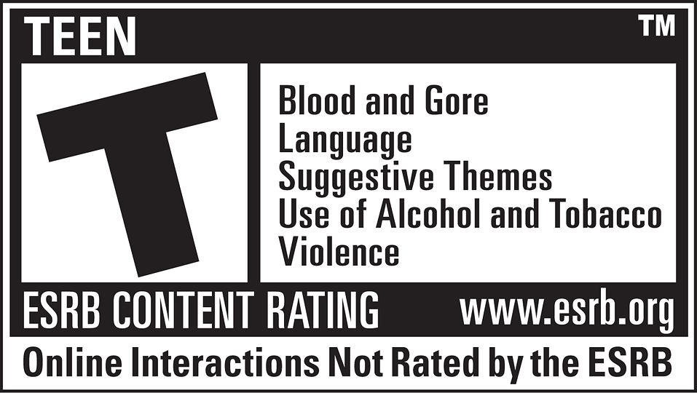
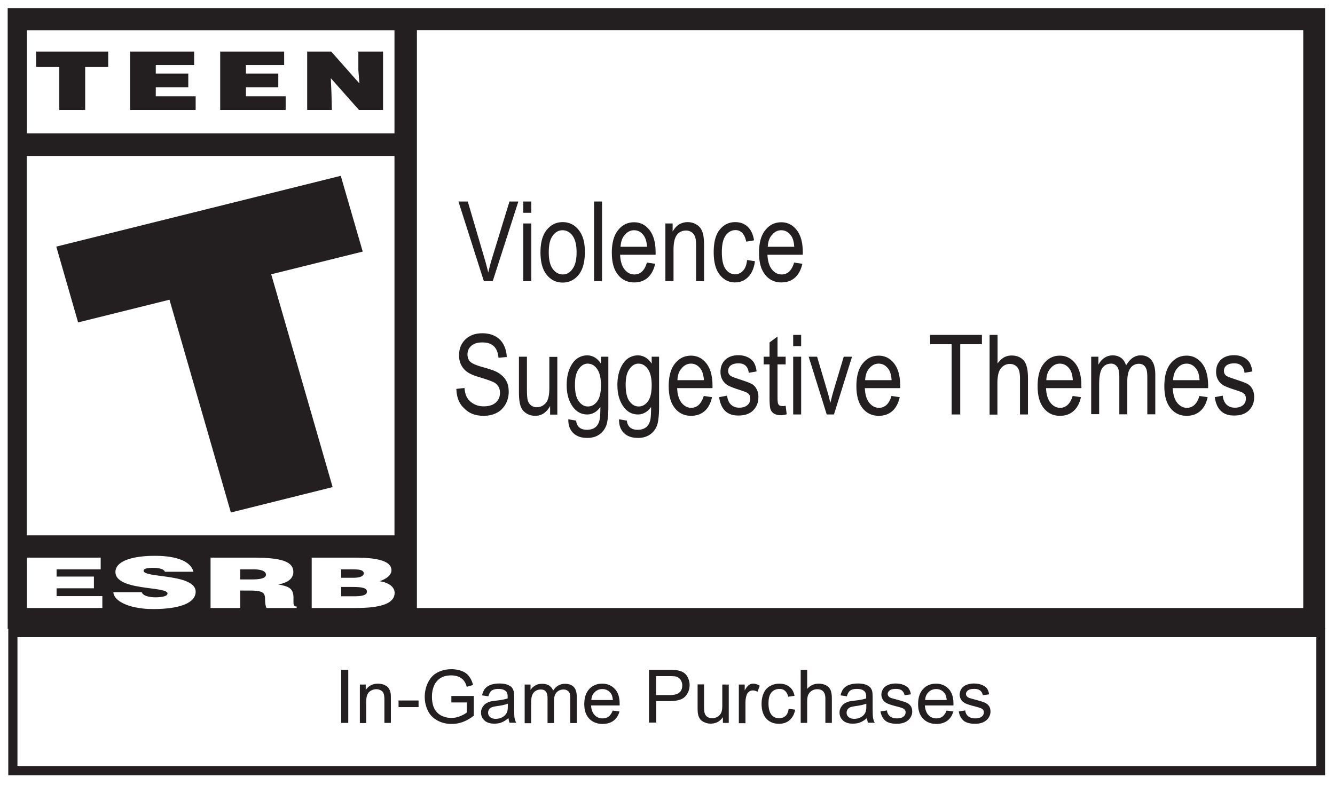
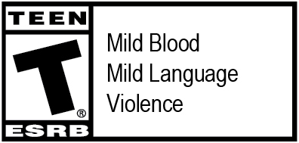
Just as movie studios are reluctant to release R rated films (fewer viewers) the most common rating for games is 'Teen' according to esrb.org

Slide 13
Questions
Do ratings influence which games get made? should they?
Should consumers be able to choose whatever content they want?
What obligations do developers have regarding protecting their users?

Slide 14
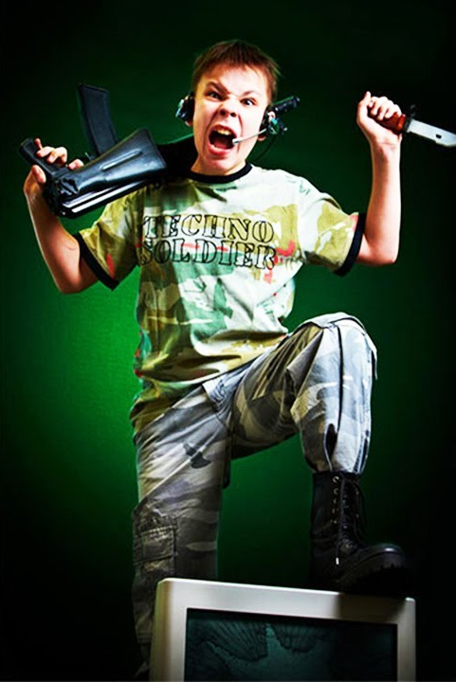
Violence In Gaming
Common statements:
... increases physiological arousal
... increases aggressive thoughts
... increases aggressive emotions
... increases aggressive actions
... decreases positive prosocial actions
... trains our youth in combat tactics needed for the
revolution
This Photo by Unknown Author is licensed under CC BY-SA-NC

Slide 15
In actuality…
Short term increases in aggressive behavior has been shown
A few hours
The rest of the claims… largely unproven.
The US Army funded a game in the hopes of using it for training to mixed results.
There was an increase in team cohesion and communication…

Slide 16

Social Activity
Some studies (CITATION NEEDED!) have shown an increase in prosocial behavior related to playing video games
Thoughts?

Slide 17

Questions
Do software developers have a social responsibility to the users of their products?
How does violence in video games compare to violence in other media?
What if I am using Google to look up "The Anarchists Cookbook"?
What if Word, Powerpoint, Photoshop, GiMP, etc. are used to plan terrorist activity?

Slide 18


Counter Argument
A study randomly assigned 'prestige' cars (Mercedes, BMW, etc.) and 'non-prestige' cars (Honda, Toyota, etc.) to drivers. The drivers of the prestige cars exhibited an increase in anti-social behavior.
Should luxury cars be regulated?

Slide 19
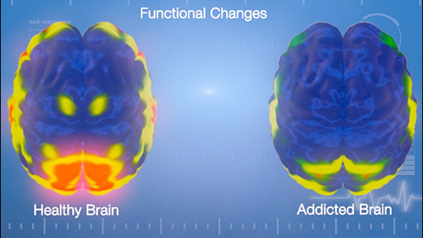
Brain Changes
There are some studies that have shown a clear sign of changes in the brain after playing games[6]
What these changes mean, however, is unclear.

Slide 20
My concern: Negative impact on mental health
How do games impact our mental health?
Personally, I get tetchy if I go too long without playing a game
What about games that influence how we see the world?
The show 13 Reasons Why has been correlated with an increase in suicidal ideation in teens.
would games have a stronger or weaker influence?
https://www.xkcd.com/552/

Slide 21

Messaging
What Responsibility Does a software developer have on the type of messaging being delivered?

Slide 22
Gender and Sexuality in Software

Slide 23
What percentage of software developers are male? (as of the 2017 census)
60%
Hold up 1 finger
70%
Hold up 2 fingers
80%
Hold up 3 fingers
90%
Hold up 4 fingers

Slide 24
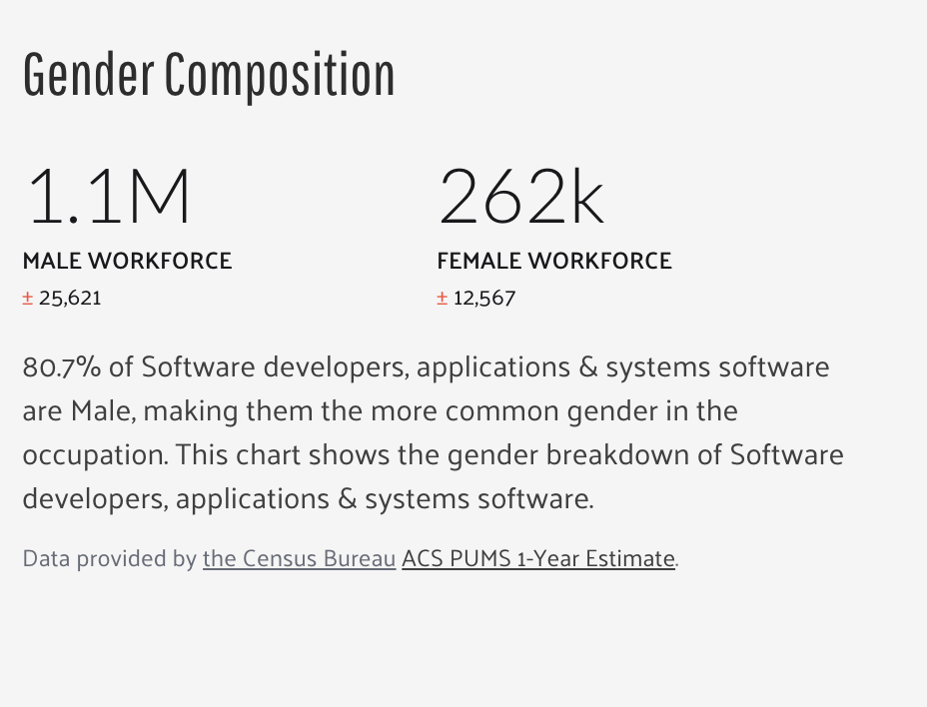
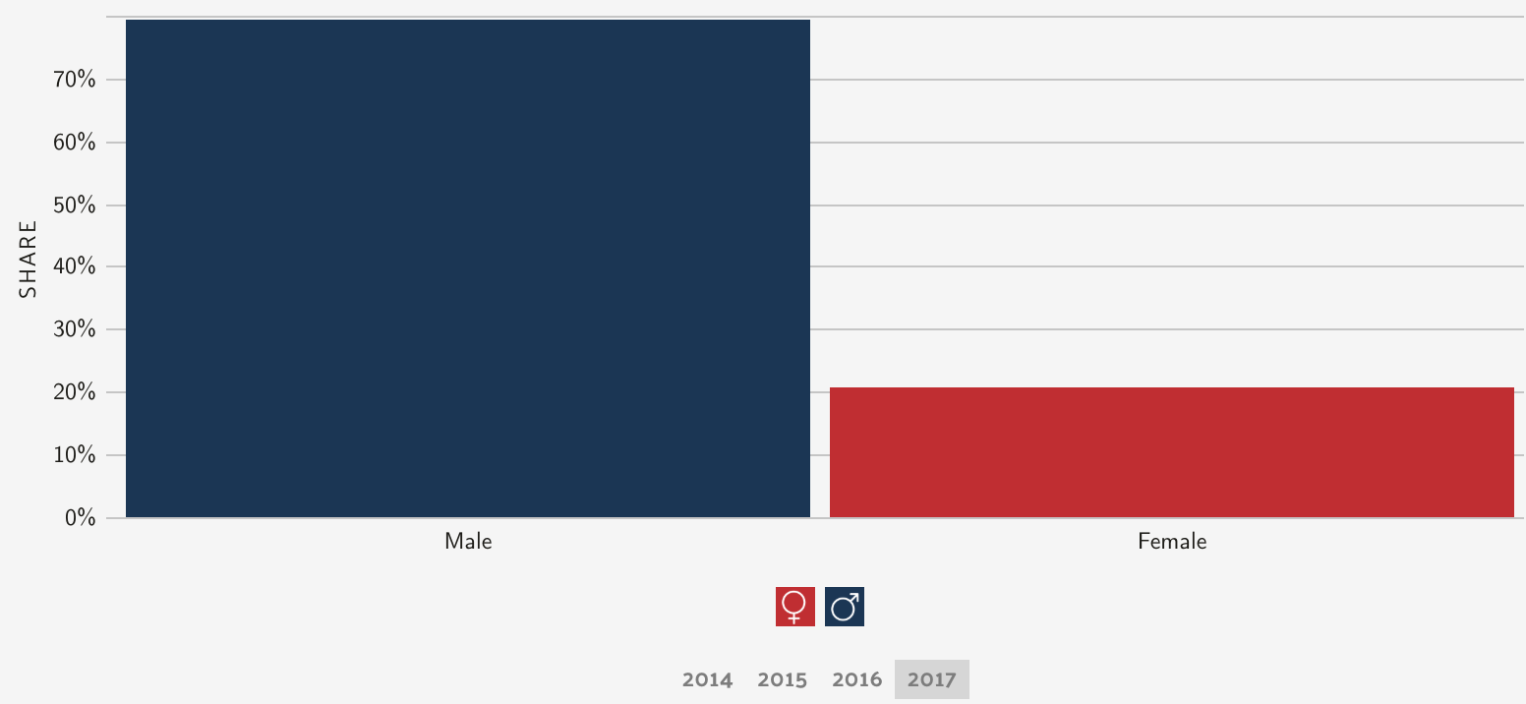
Software developers by gender in 2017
Source: https://datausa.io/profile/soc/15113X/#demographics

Slide 25
Software developers by gender in 2017
80.7% of software developers are male
Source: https://datausa.io/profile/soc/15113X/#demographics

Slide 26
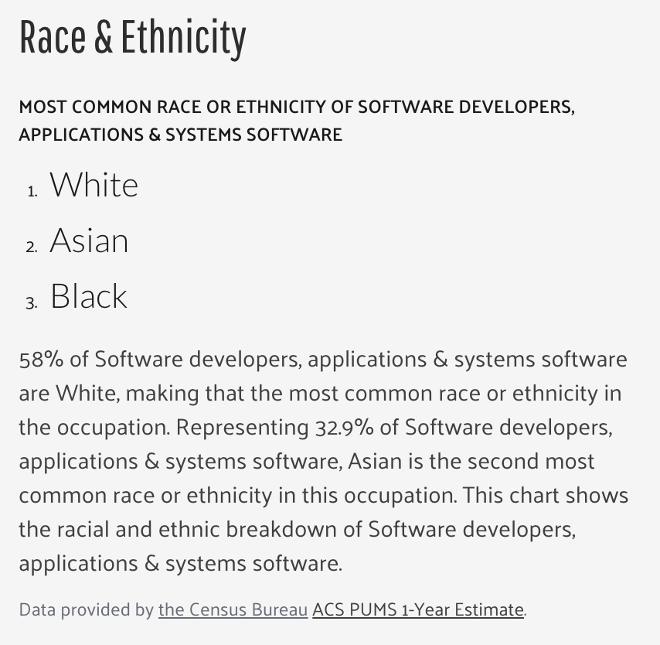
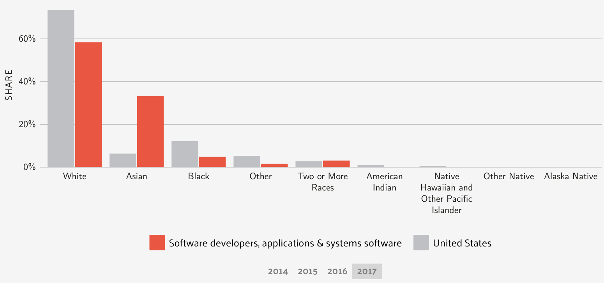
Census bureau data on race and ethnicity of software developers
Source: https://datausa.io/profile/soc/15113X/#demographics

Slide 27
What this means
MOST software is being written by white males. Specifically white males under the age of 40^{[7]}.
Think about that for a moment…

Slide 28
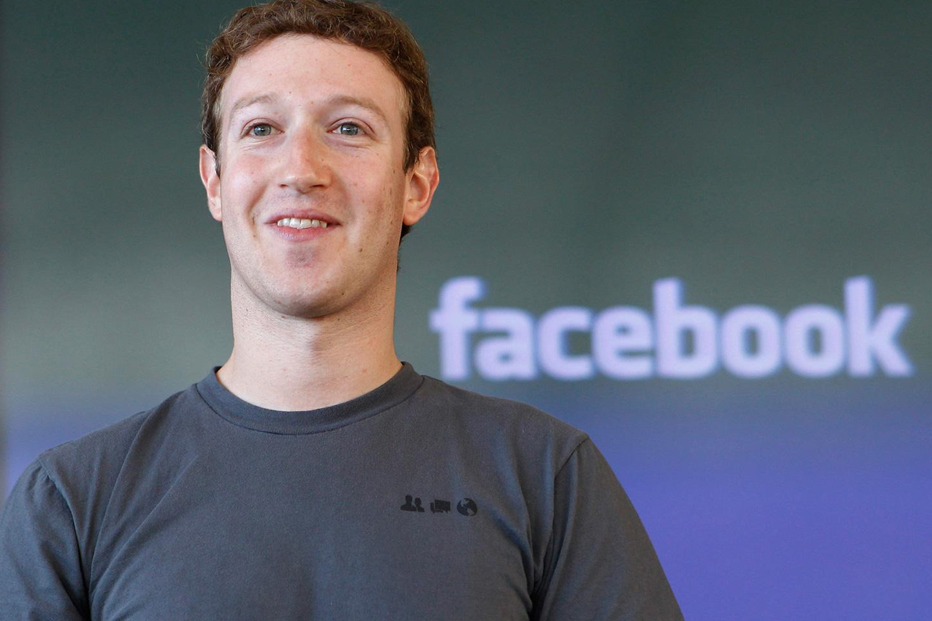
Twitter, Snapchat, Facebook

Slide 29
A small group speaking for the masses
How does their point of view influence the world?

Slide 30
Let's vote: What Percentage of gamers are female?
26%
hold up 1 finger
46%
hold up 2 fingers
66%
hold up 3 fingers
86%
hold up 4 fingers

Slide 31
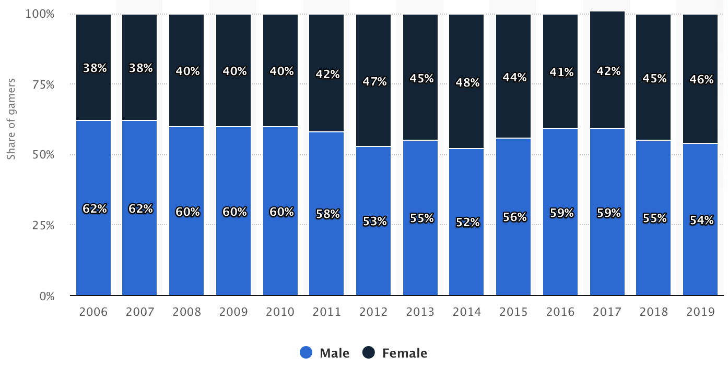
Distribution of computer and video gamers in the United States from 2006 to 2019, by gender
Source: https://www.statista.com/statistics/232383/gender-split-of-us-computer-and-video-gamers/

Slide 32


Gender in Games
How are genders treated in most games?
Who is controlling this narrative?
What about race and ethnicity?
Have we ever seen Samus and Doom Guy in the same room?

Slide 33
Who do you pick when you play?
Do you pick someone that looks like you?
Do you pick someone you like to look at?
Do you pick someone who looks how you would like to look?
More importantly: who decides who you GET to pick?

Slide 34

Punching up vs punching down
Is it okay if a CEO ridicules a worker?
What if a worker ridicules a CEO?
If the Queen of England said her subjects were unwashed peasants that is no good.
If an unwashed peasant English citizens said the Queen was an antiqued symbol of the past no one bats an eye.
This is about power and privilege.

Slide 35
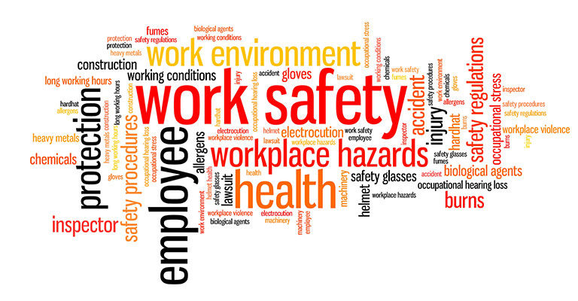
Safety & Responsibility

Slide 36
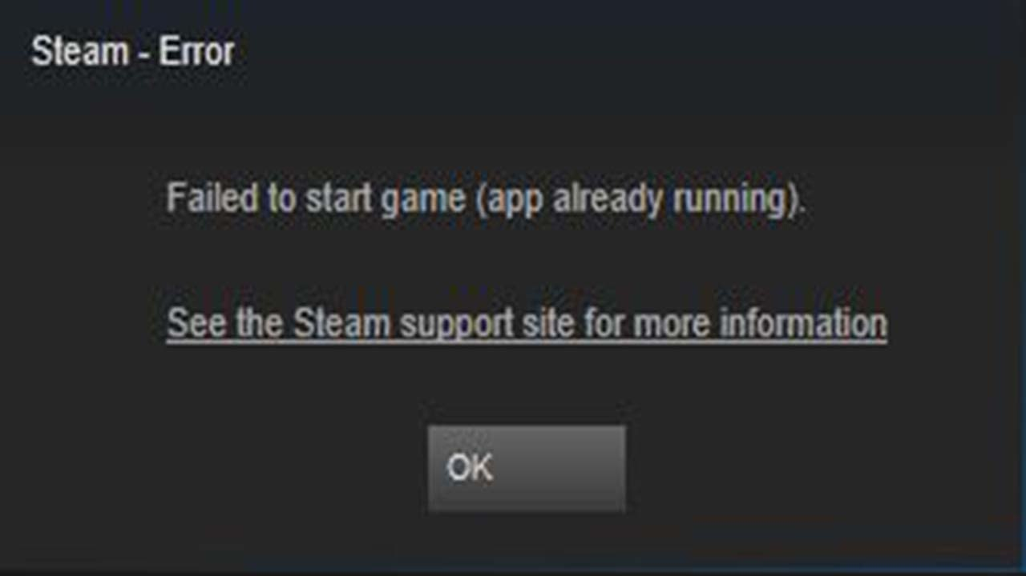
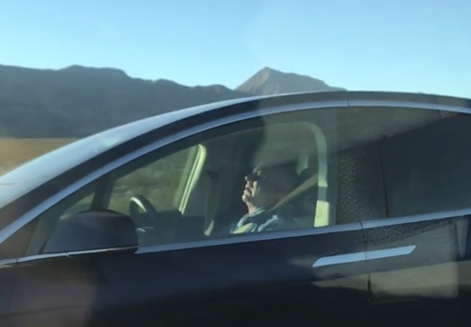
Responsibility
If a game crashes who is responsible?

Slide 37
Responsibility
If a game Tesla crashes who is responsible?

Slide 38

Raise your hand if you have ever…
gotten a decimal place wrong in your code
gotten < confused with < > in an if statement
typed && instead of ||
had an off by one error

Slide 39

What if the code was…
calculating the amount of time to bombard someone with x-rays?
calculating when to deploy a parachute?
determining when to target an airplane?
how many seconds before applying the brakes?

Slide 40
Do we have a responsibility for the health and safety of our users?

Slide 41
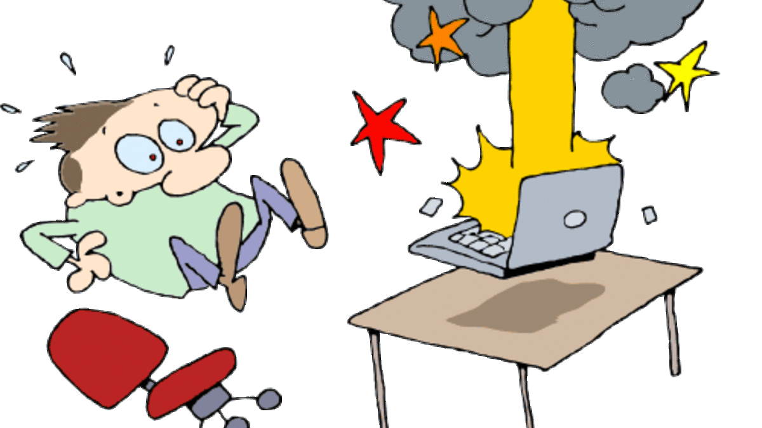
Who is responsible when software crashes?

Slide 42
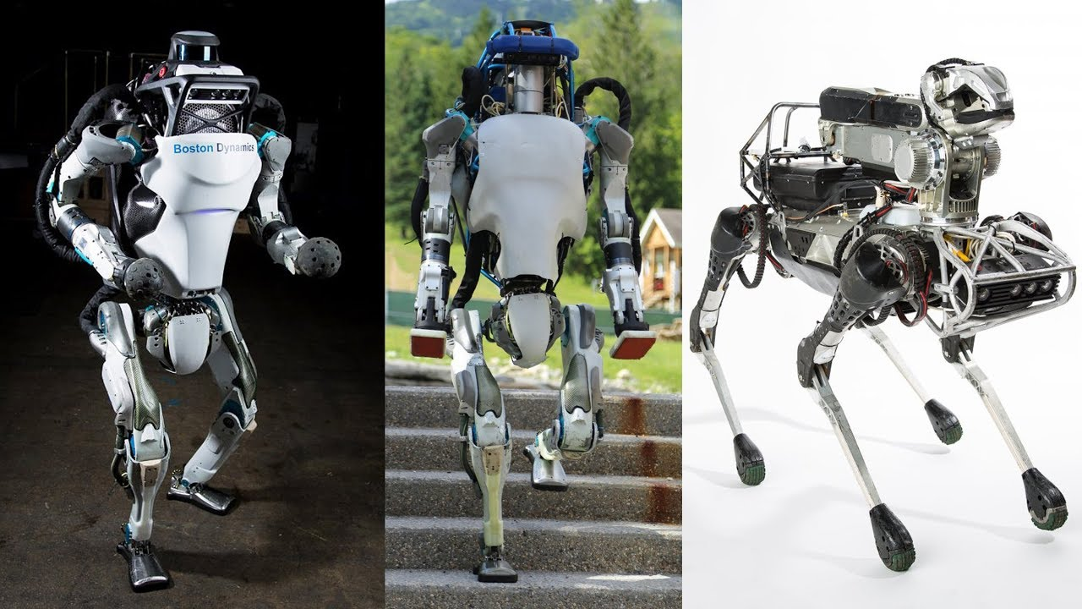
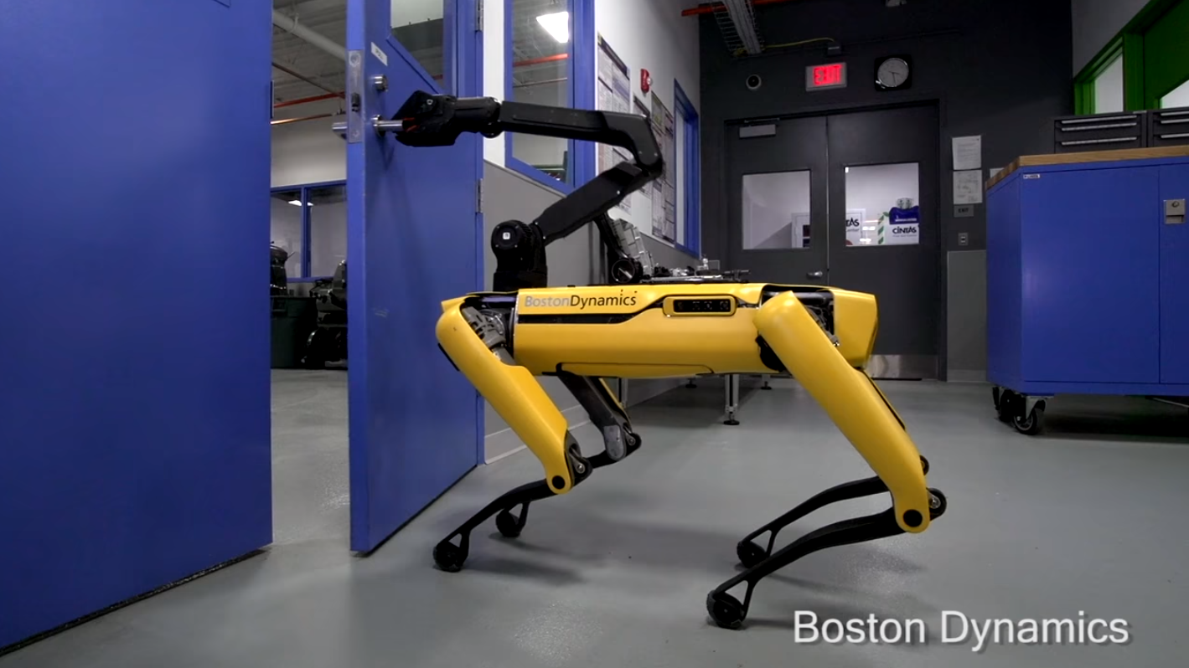
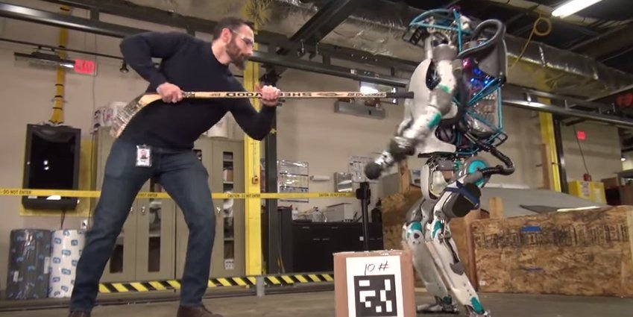
Robots
Police and military are beginning to use robots
Who is responsible if they hurt someone?
Would you rather have a human or a robot police officer?
Who wrote the code?

Slide 43
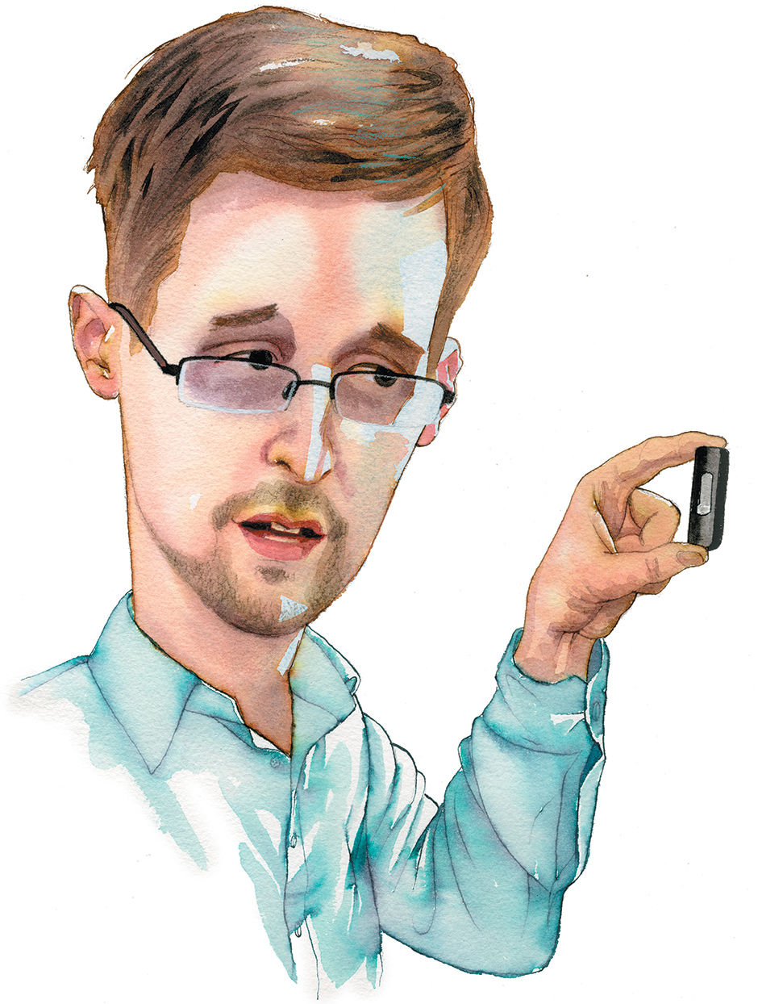
Privacy
What reasonable expectation of privacy do we have in the digital era?
As software developers where do we draw the line?
What if we discover something?

Slide 44
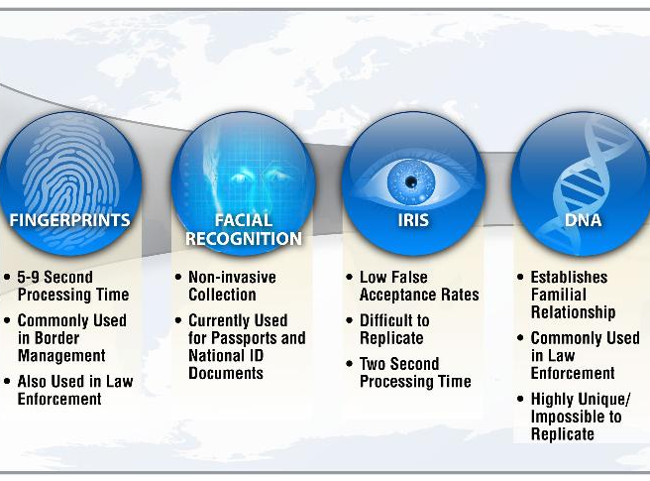
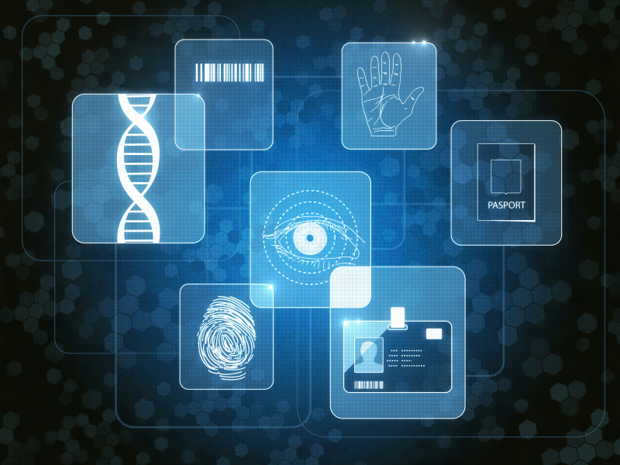
Biometrics
Using facial recognition to unlock an iPhone was notoriously problematic for people of color
Voice assistants (Siri, Cortana, Google Assistant, etc.) tend to not work well for women
Or anyone without an American accent
At best this is an oversight, at worst this is gatekeeping.
I have been told this is also leading to a loss of native dialects… which may have a cultural impact…

Slide 45
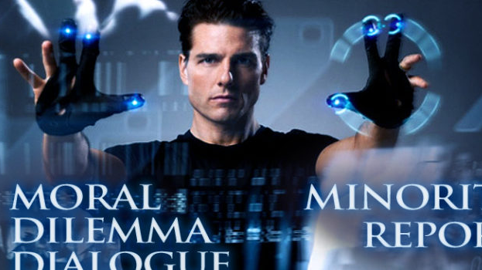
Biometric Tracking
Do we want Google etc to be able to track us based on our face?
What about how we walk?
What about using machine learning to predict who will commit a crime?

Slide 46
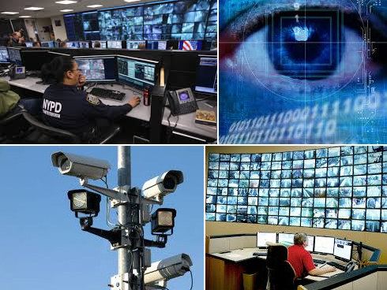

You Decide
The future is yours to shape.
Think about what choices you make
Think about your future, the future of others, and what kind of world you want to live in…

Slide 47
Sources
Piracy helps some firms: https://www.researchgate.net/profile/Rodrigo_Nobre_Fernandez/publication/324804247_Effects_of_Software_Piracy_on_Economic_Growth/links/5ae33b87aca272fdaf904de2/Effects-of-Software-Piracy-on-Economic-Growth.pdf
https://www.esrb.org/
ESRB wiki: https://en.wikipedia.org/wiki/Entertainment_Software_Rating_Board
https://pegi.info/
PEGI wiki : https://en.wikipedia.org/wiki/Pan_European_Game_Information
Brain changes after playing games: https://www.discovermagazine.com/mind/call-of-mri-action-video-games-and-the-brain
Stats on software developers: https://datausa.io/profile/soc/15113X/#demographics

